Slide 1

ARHS PGO
Your generous donations
Make it Possible

Slide 2
ARHS PGO
What we do for you:
Parent/Guardian Newsletter
ARHSparentCenter.org

Slide 3
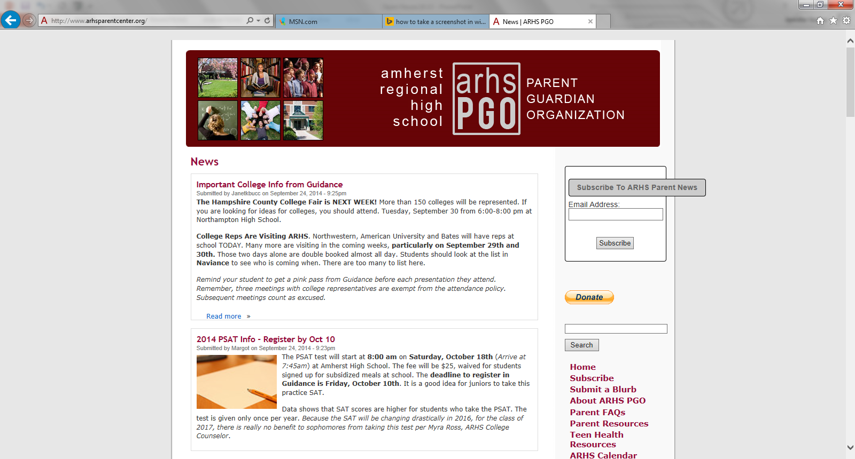
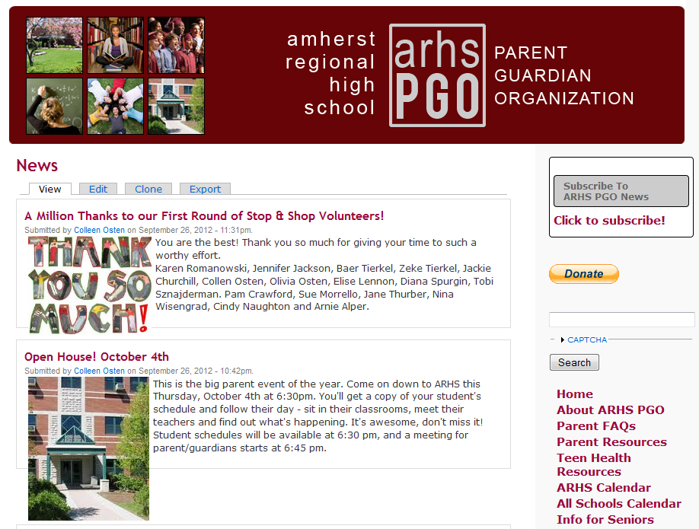
ARHS PGO

Slide 4
ARHS PGO
What we do for you:
Parent/Guardian Newsletter
ARHSparentCenter.org
Teacher and Student Grants

Slide 5

ARHS PGO
NO COST TO YOU!
Stop & Shop’s A+ School Rewards Program
www.stopandshop.com
MORE THAN $77,000 RAISED
OVER THE LAST 4 YEARS!
Notes:
5

Slide 6
ARHS PGO
What we do for you:
Parent/Guardian Newsletter
ARHSparentCenter.org
Teacher and Student Grants
Community Building

Slide 7


ARHS PGO
Community Building Through:
Teacher/Staff Appreciation Breakfast and Luncheon
New Families Welcome
Information sessions: College Process, Course Registration
Dialogue Day Support
Direct Donation to ARHS PGO
Mail or drop it by the school
Any amount helpful!
Notes:
7

Slide 8
ARHS PGO
Please Join Us!
Contact: arhspgonews@gmail.com
Notes:
8

