Slide 1


Slide 2

Got an IEP/504?
So do about 20% of students in our schools.

Slide 3

Got Dyspraxia?
Daniel Radcliffe does.

Slide 4
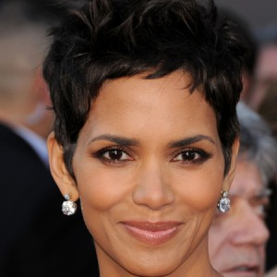
Got Diabetes?
Halle Barry does.

Slide 5
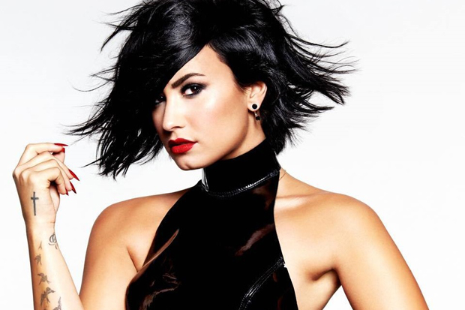
Got Bipolar Disorder?
Demi Lovato Does!
s

Slide 6
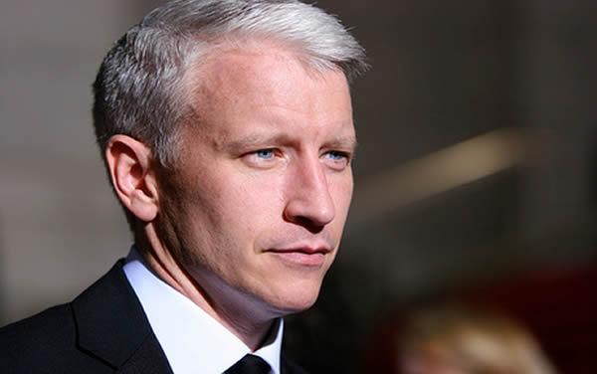

Got Dyslexia?
Got Dyslexia?
Anderson Cooper Does.

Slide 7
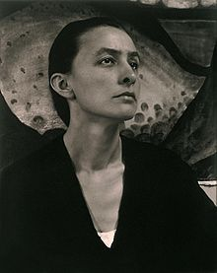

Got a Vision Impairment?
Georgia O’Keefe did.

Slide 8
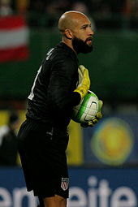
Get Tourette's?
Tim Howard does.

Slide 9
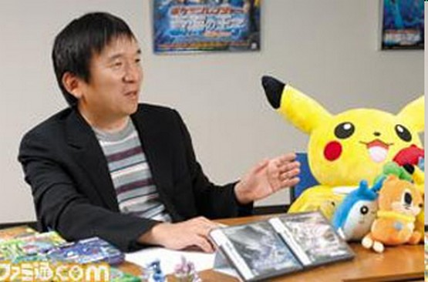
Got Autism?
Satoshi Tajiri Does.

Slide 10
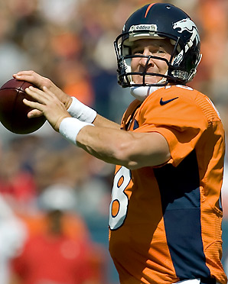
Got a speech impairment?
Peyton Manning did.

Slide 11
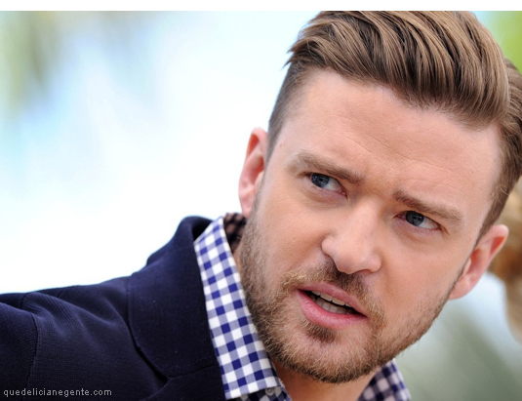
Got OCD?
Justin Timberlake does.

Slide 12
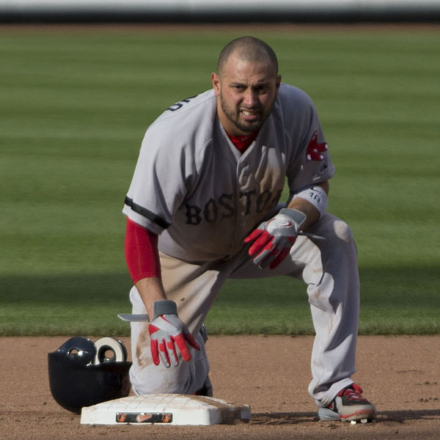
Got ADHD?
Shane Victorino does.

Slide 13
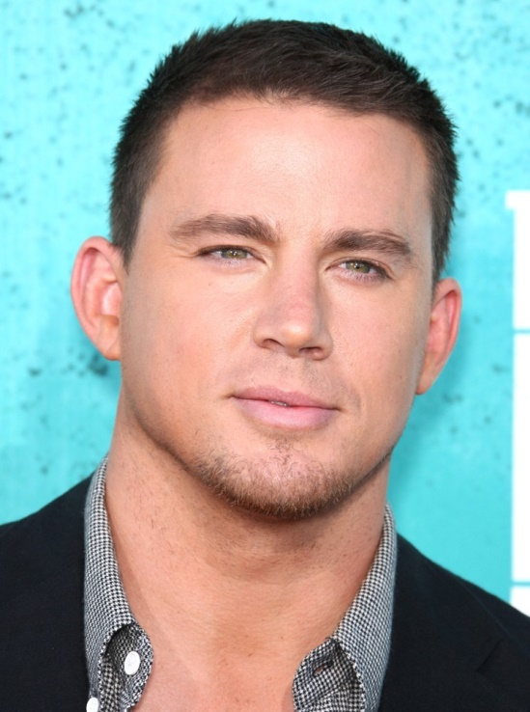
Got ADHD?
Channing Tatum does.

Slide 14
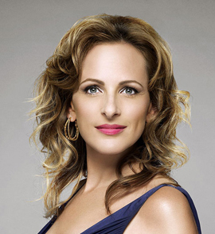
Got a hearing impairment?
Marlee Matlin does.

Slide 15
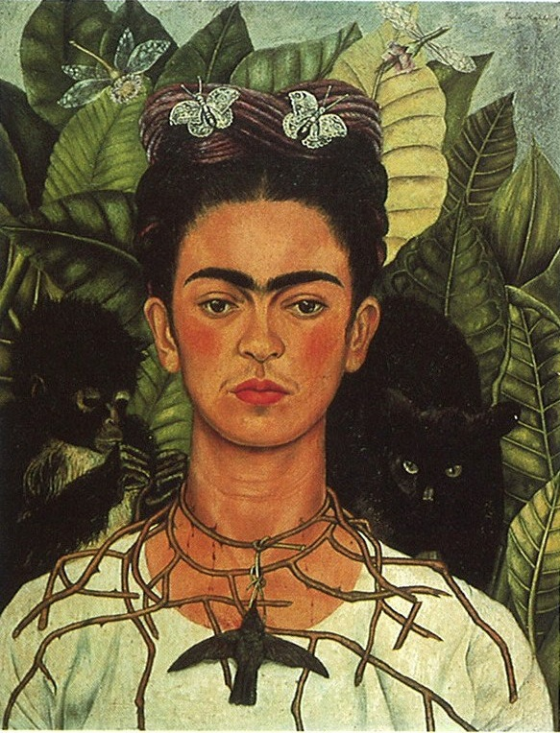
Have a mobility impairment?
Freida Khalo did.

Slide 16
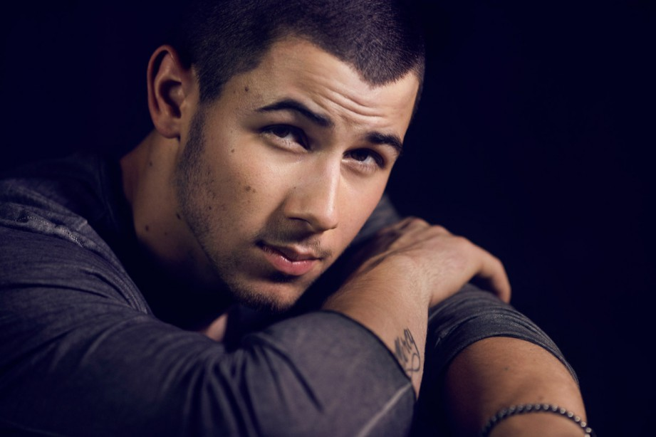
Got diabetes?
Nick Jonas does.

Slide 17
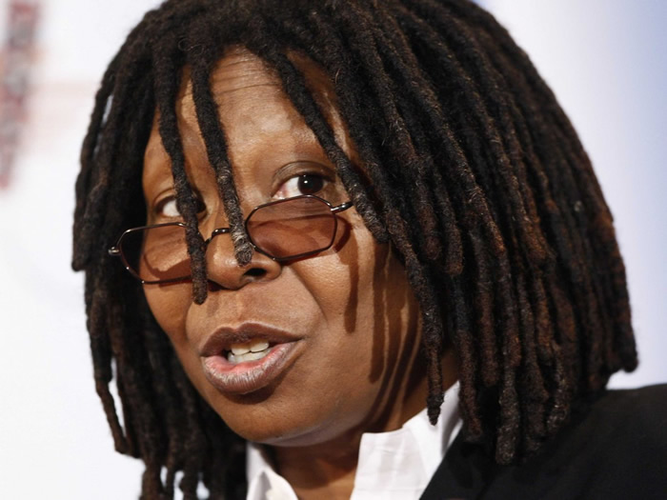
Got Dyslexia?
Whoopi Goldberg does.

Slide 18
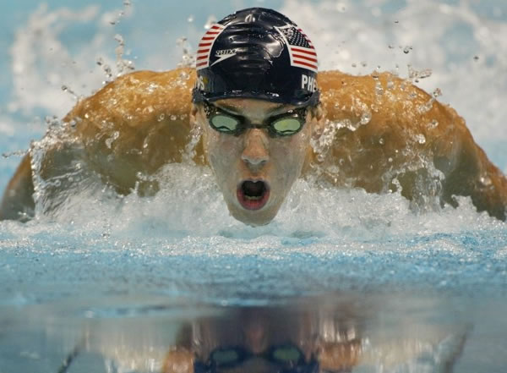
Got ADHD?
Michael Phelps does.

Slide 19
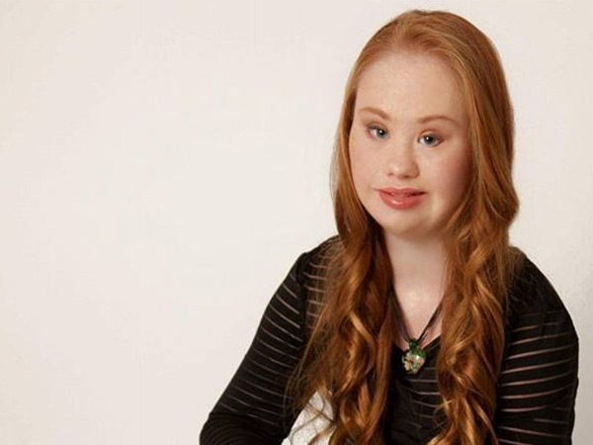
Got Down Syndrome?
Madeline Stuart does.

Slide 20
